Slide 1
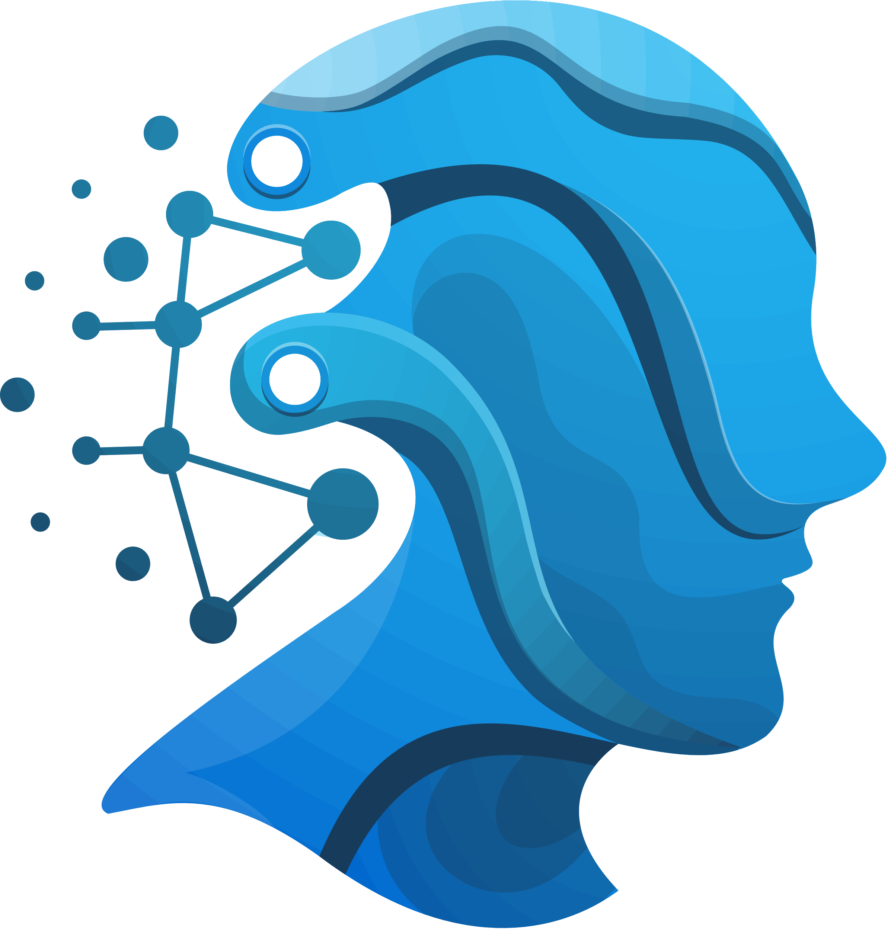

Thynk Unlimited
Autonomous Ai Agent
&
Multi-Agent System

Slide 2

Thynk Unlimited
Introduction
Autonomous Agents and Multi-Agent Systems (MAS) are central concepts in modern AI.
Autonomous agents act without continuous human intervention
MAS involves multiple intelligent agents interacting
Used in robotics, transportation, healthcare, cybersecurity, finance, and smart cities
Example: Self-driving cars making decisions without human control demonstrate autonomous agent behavior.

Slide 3
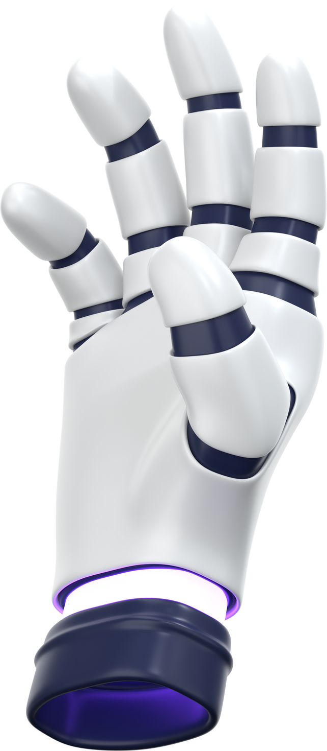

Thynk Unlimited
What is an Ai Agent?
According to Russell & Norvig (Artificial Intelligence: A Modern Approach):
“An agent is anything that perceives its environment through sensors
and acts upon that environment through actuators.”
Key Points
Perceives → processes → decides → acts
Works continuously
Goal-oriented behavior
Example
Google Assistant listens (sensor), understands, decides, and responds (actuator).

Slide 4

Thynk Unlimited
Autonomous Ai Agent
Autonomous agents:
Operate independently
Make decisions without human commands
Handle changing environments
Learn from past experiences
Optimize tasks over time
Example: NASA’s Mars Rover operates autonomously on Mars, navigating terrain and collecting data.

Slide 5
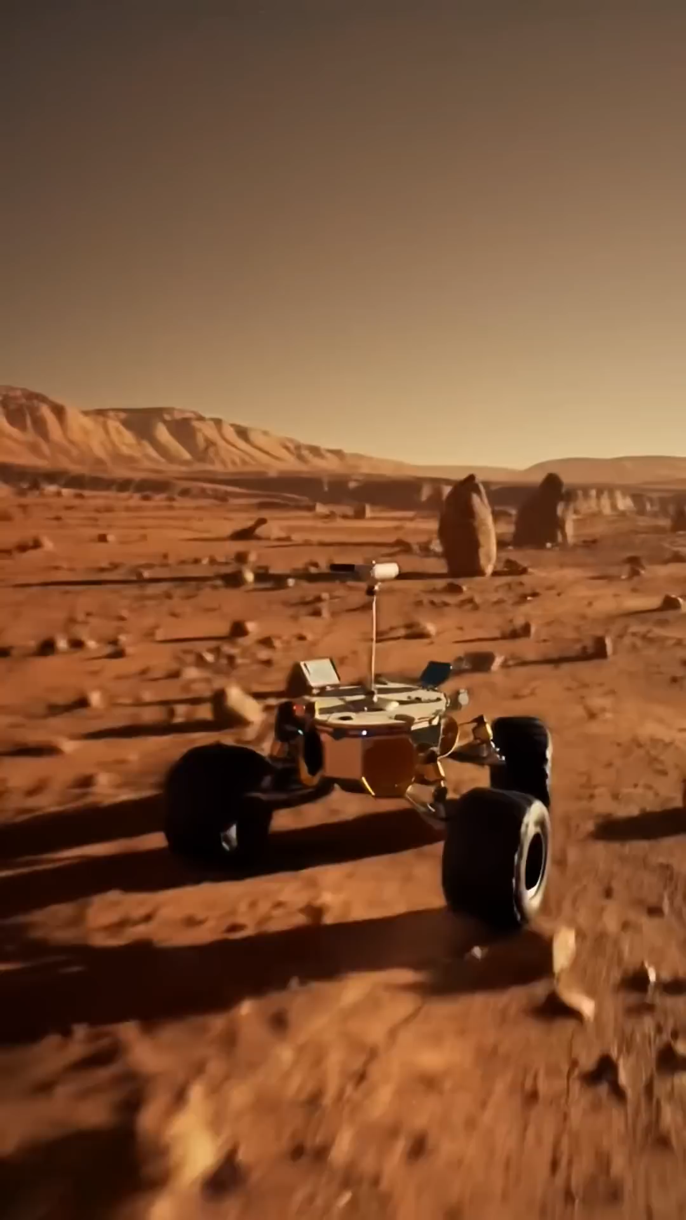

Slide 6
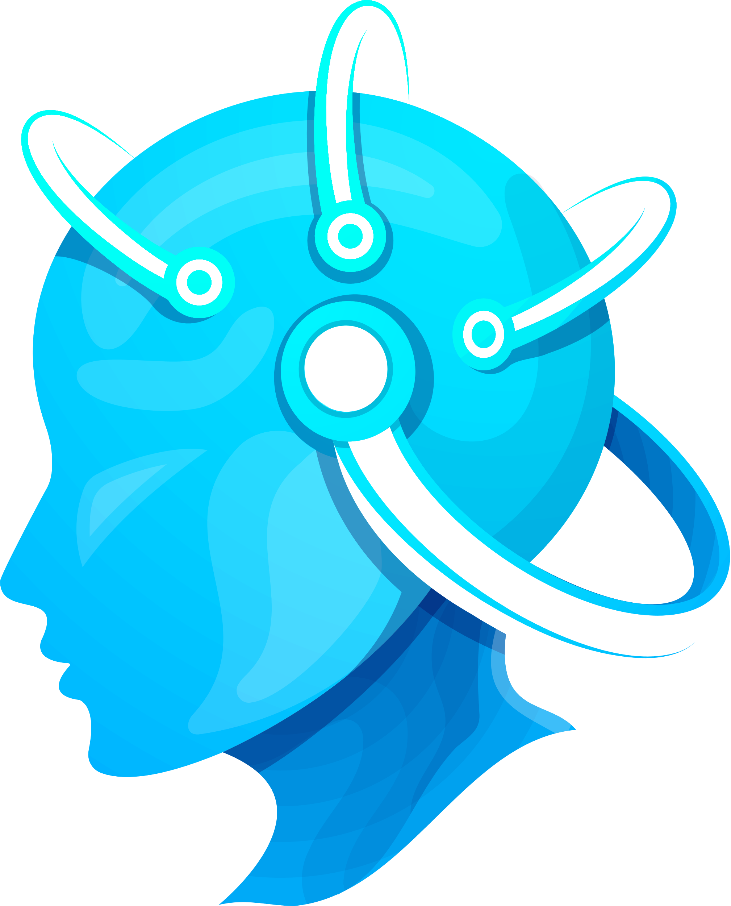
Thynk Unlimited
Characteristics
Autonomy – No constant human supervision
Reactivity – Respond to environmental changes
Proactivity – Take initiative to achieve goals
Social Ability – Communicate with humans or agents
Learning Ability – Adapt using machine learning
Example: ChatGPT-based AI assistants learn user preferences over time.

Slide 7
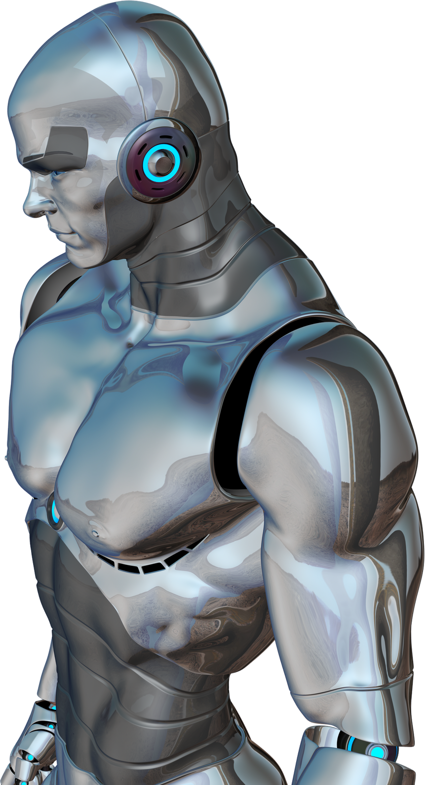
Thynk Unlimited
Types of Ai Agent
Simple Reflex Agents → react to current input only Example: Thermostat
Model-Based Agents → use memory of past states Example: Vacuum robots with mapping systems
Goal-Based Agents → choose actions to reach goals Example: GPS navigation systems
Utility-Based Agents → choose best outcome Example: Stock trading AI
Learning Agents → improve through experience Example: AlphaGo by DeepMind

Slide 8
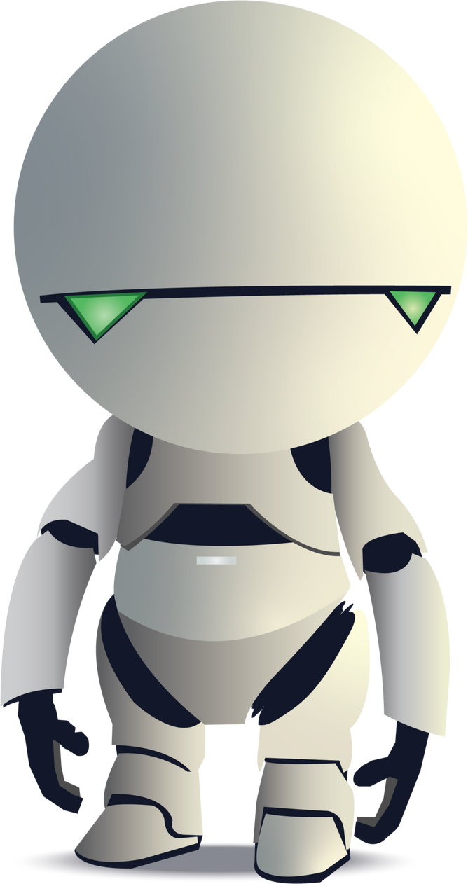
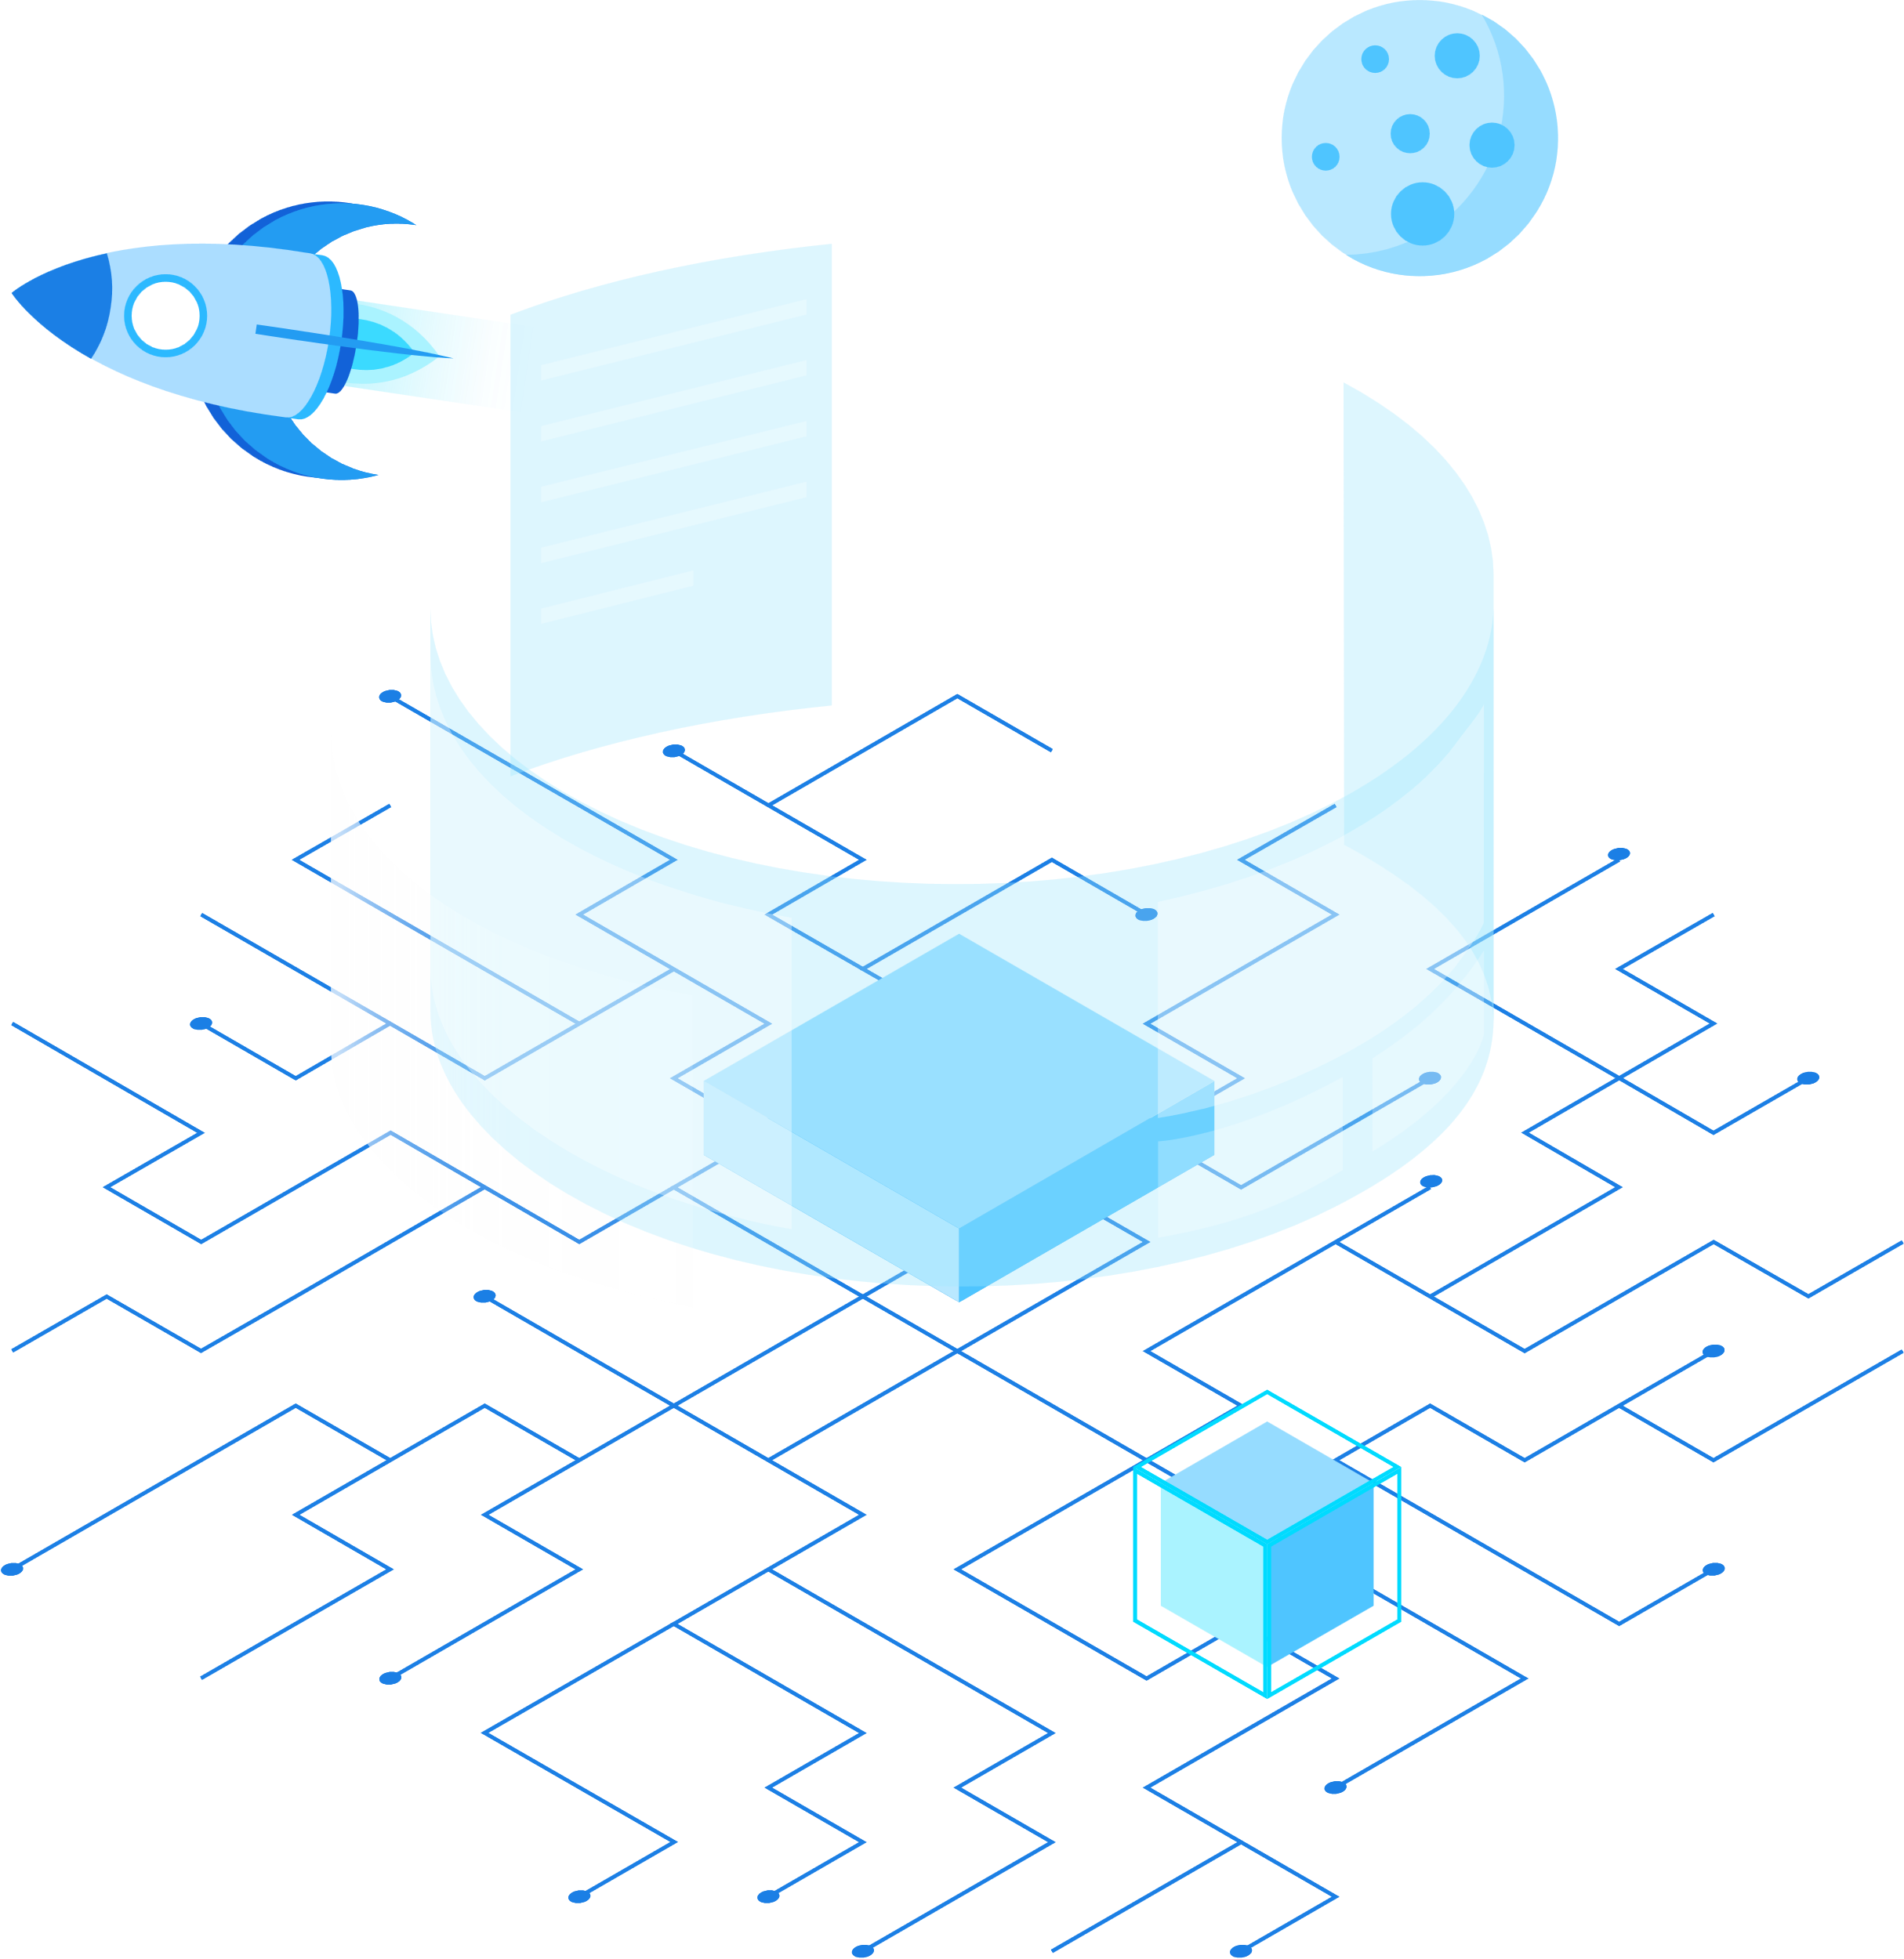
Thynk Unlimited
What is Multi-Agent System?
A Multi-Agent System is:
“A system composed of multiple interacting intelligent agents working in a shared environment.”
Properties
Decentralized intelligence
Agents may cooperate or compete
Inspired by human societies and nature (swarm intelligence)
Example: Air-traffic control systems using multiple AI agents to manage aircraft safely.

Slide 9
Thynk Unlimited
Why Multi-Agent System?
Solve complex problems better than a single agent
Distributed problem solving
Faster and parallel processing
Scalability
Increased reliability and fault tolerance
Example: Google uses MAS for distributed web crawling and indexing.
www.reallygreatsite.com

Slide 10


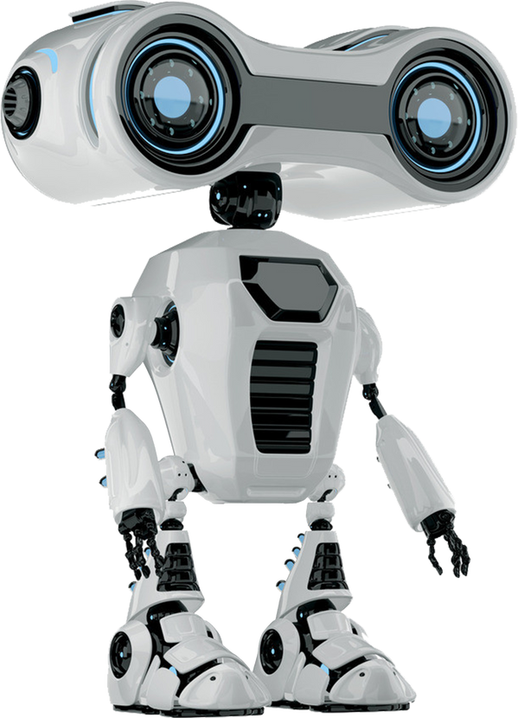

Thynk Unlimited
Types of interaction in MAS
Cooperative MAS
Agents share goals and work together
Example: Rescue robots in disaster management
Competitive MAS
Agents compete for limited resources
Example: Online auction bidding agents
Hybrid MAS
Both cooperation and competition
Example: Multiplayer online gaming AI
www.reallygreatsite.com

Slide 11
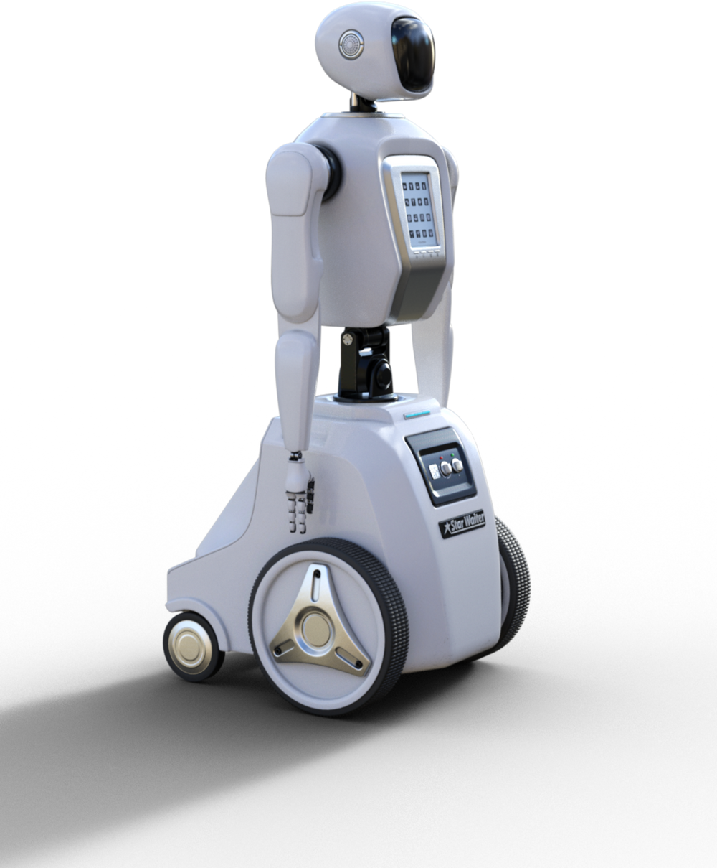
Thynk Unlimited
Architecture of MAS
A MAS typically includes:
Environment
Autonomous Agents
Communication Framework
Coordination Mechanisms
Decision Modules
Learning Components
Example: Smart grid energy management where agents manage electricity distribution and consumption.

Slide 12
Thynk Unlimited
Communication in MAS
Agents communicate using:
Message Passing (FIPA-ACL Standards)
Blackboard Systems
Negotiation Protocols
Cooperation Strategies
Conflict-Resolution Methods
Example: Multiple delivery drones coordinate routes to avoid collisions.

Slide 13

Thynk Unlimited
Real World Applications of MAS
Real-World Applications of MAS
Smart Traffic Systems – AI agents controlling signals
Healthcare Systems – multi-agent hospital management
Defense Simulations
E-Commerce Negotiation Agents
Swarm Robotics
Smart Cities
Distributed Cloud Computing
Example
Singapore uses MAS for smart city traffic and infrastructure management.

Slide 14
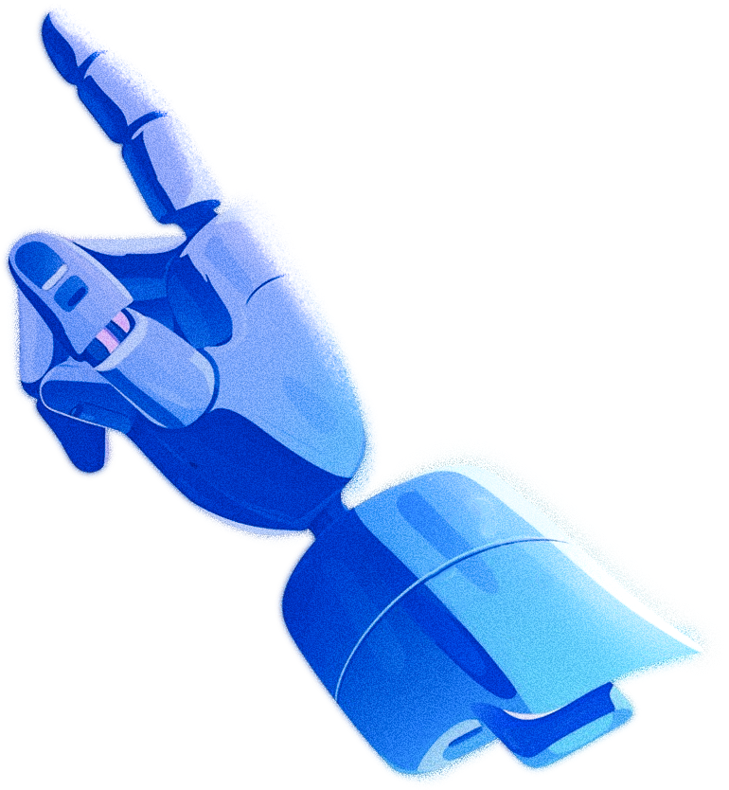
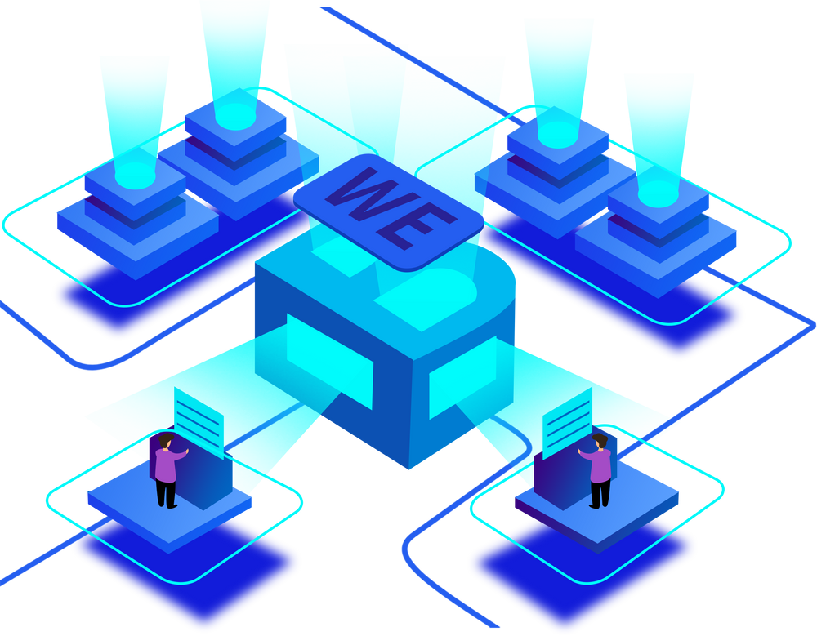
Thynk Unlimited
Coordination Complexity
Communication Overhead
Decision Conflicts
Ethical & Legal Concerns
Trust and Security Issues
Scalability Problems
Reliability
Example: If multiple autonomous cars miscommunicate, accidents may occur.
Challenges

Slide 15
Thynk Unlimited
More human-like reasoning
Stronger learning and adaptation
Integration with IoT, Big Data & Cloud
Fully autonomous industries and transportation
Safer and ethical AI agents
Smart, fully autonomous cities
Example: Future cities will have AI managing traffic, energy, healthcare, and services autonomously.
Future of
Ai Agents

Slide 16
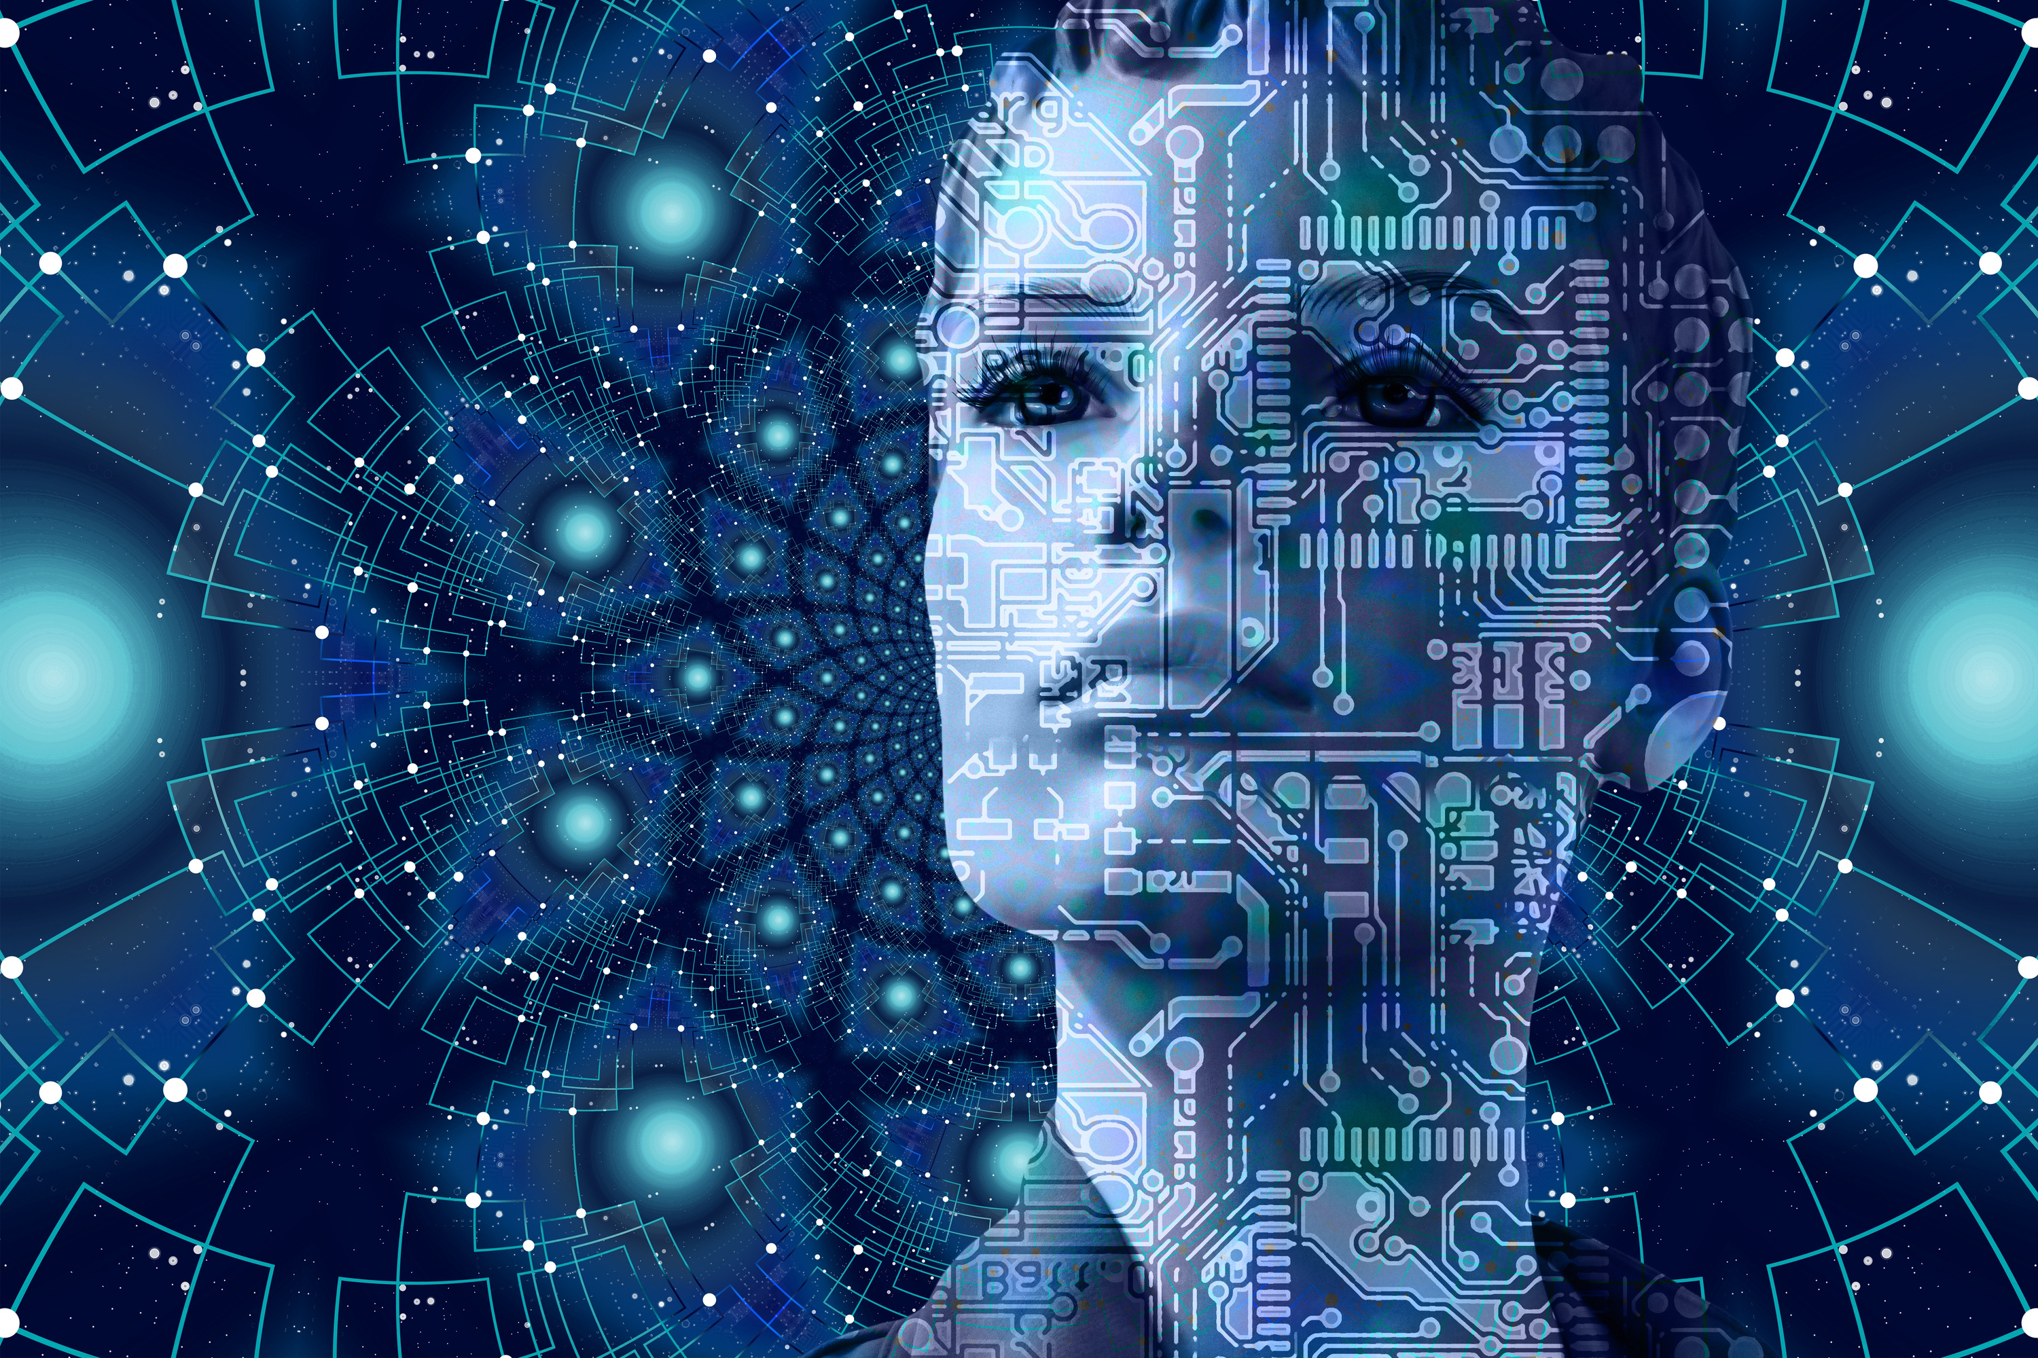
Thynk Unlimited
Any Question?

Slide 17
Thynk Unlimited
THANK YOU.

